Slide 1




Comparing Proportions of Cat Related Tweets in the United States
Kaitlyn Lawlor
April 28, 2017

Slide 2
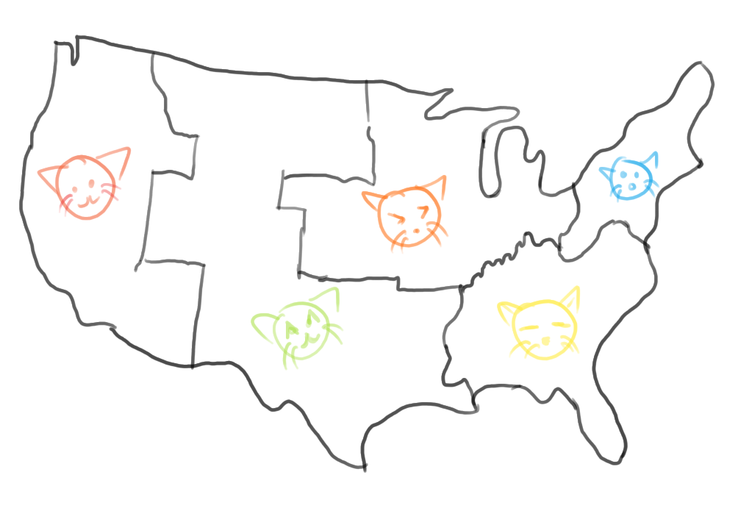
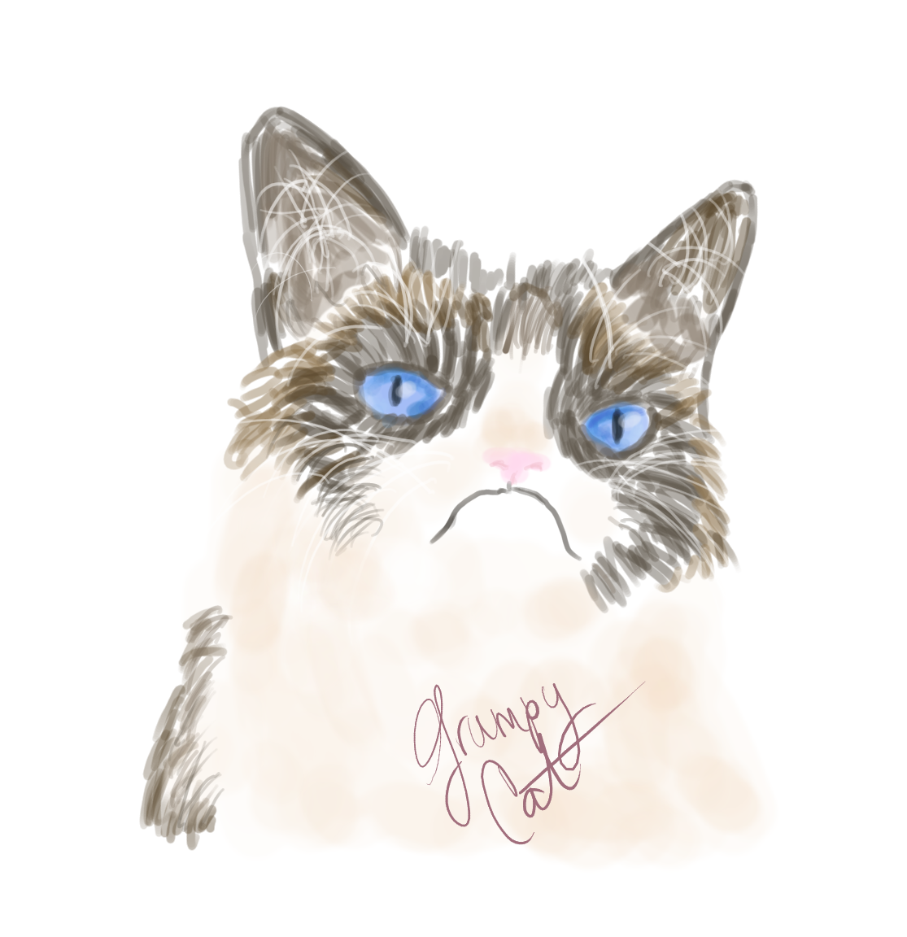
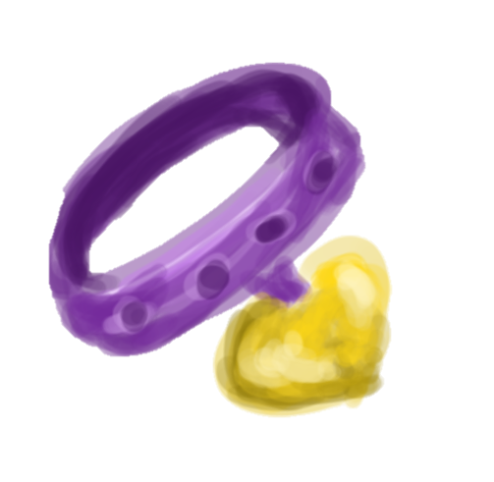













popularity
marketing
Notes:
Consumption of online cat-related media is heavily understudied, considering the large viewership of feline-related content.

Slide 3






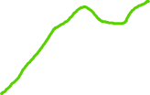
Objective: Report the region of the U.S. that is most interested in cats.

Slide 4
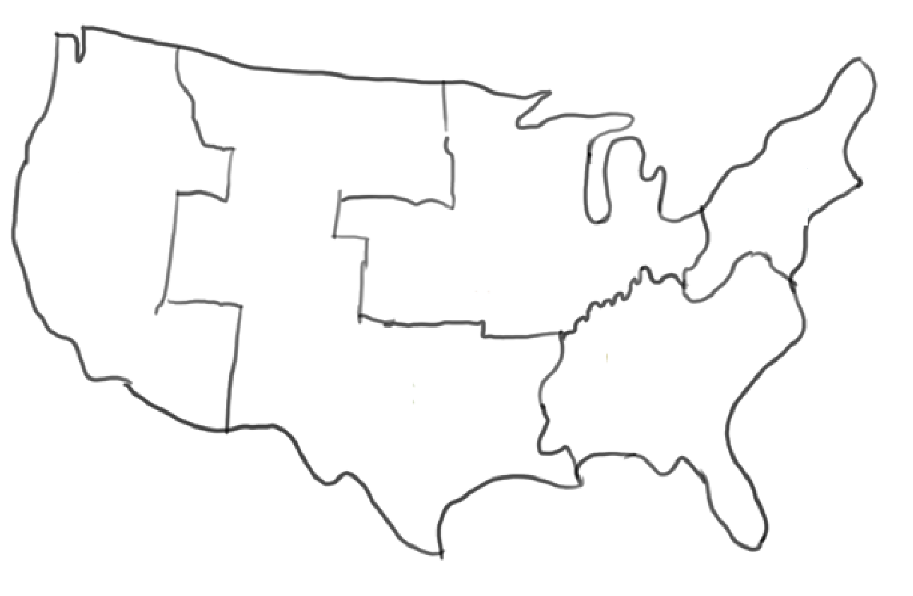
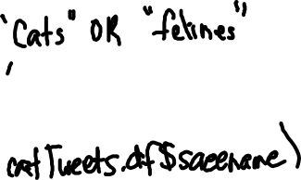






















twitteR
ggmaps
Notes:
twitteR interface for the Twitter API

Slide 5
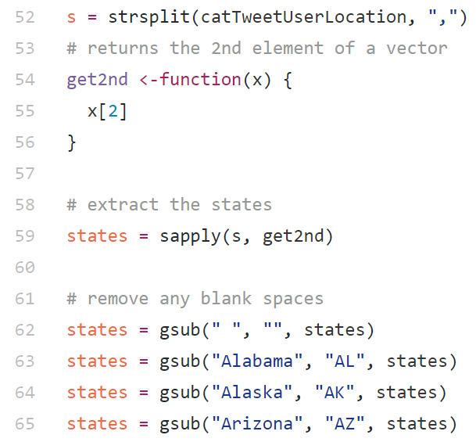
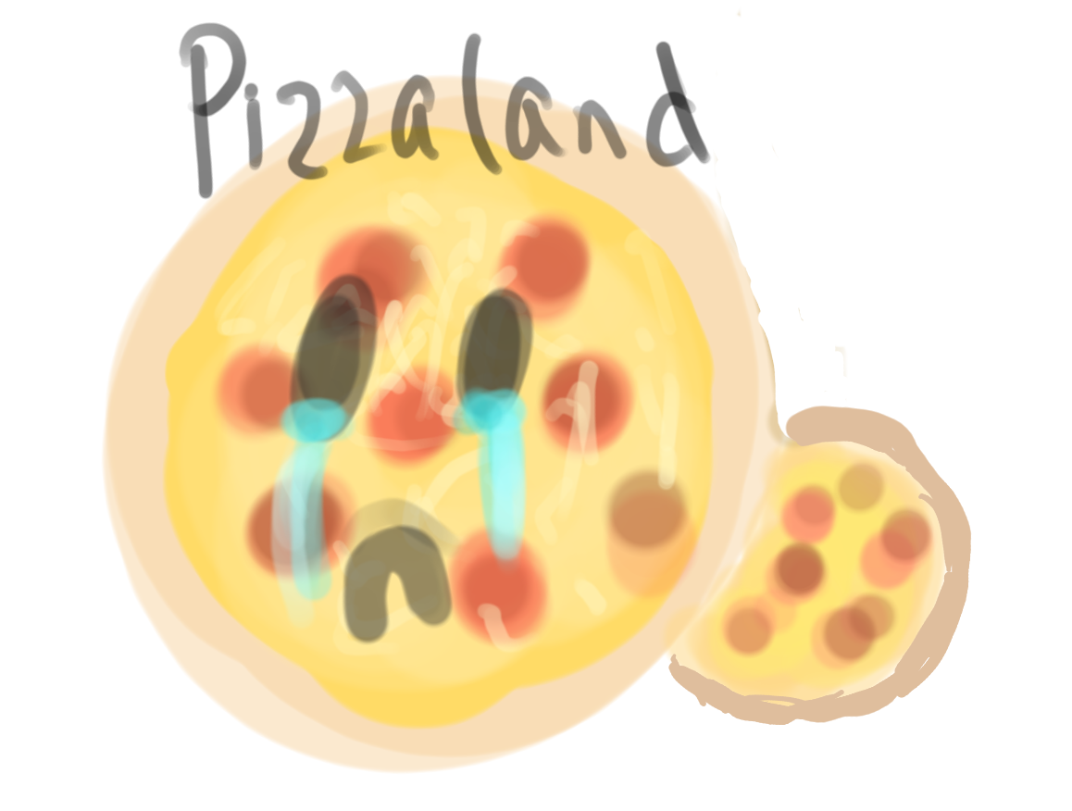
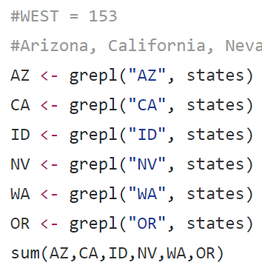







Notes:
1298 obs first dataframe
1056 obs second dataframe

Slide 6
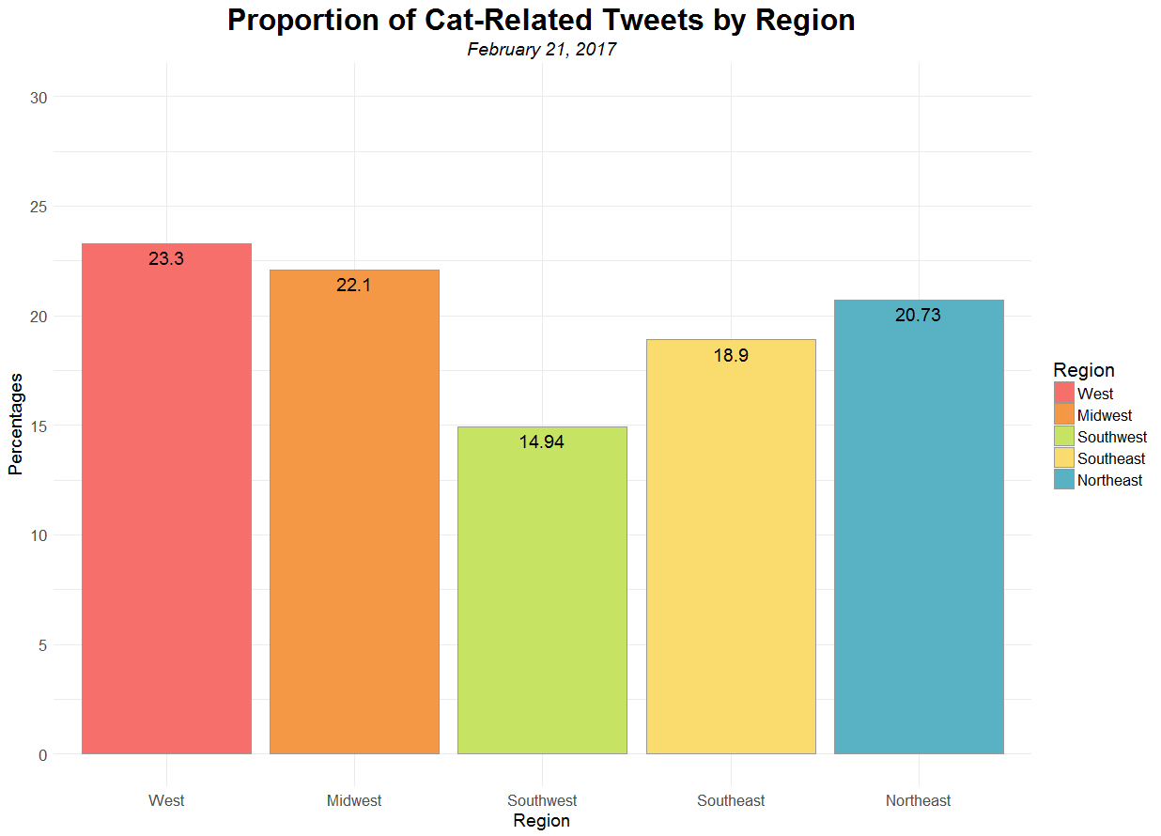
656 tweets

Slide 7
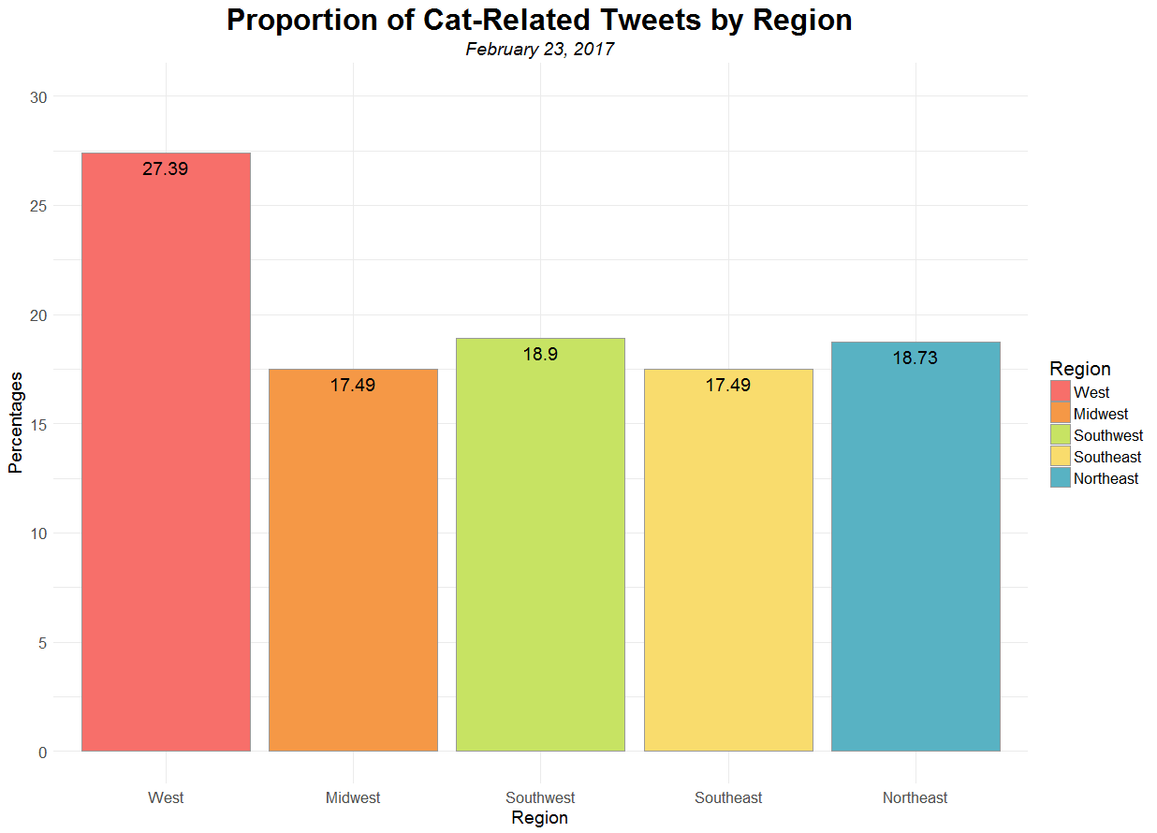

Slide 8
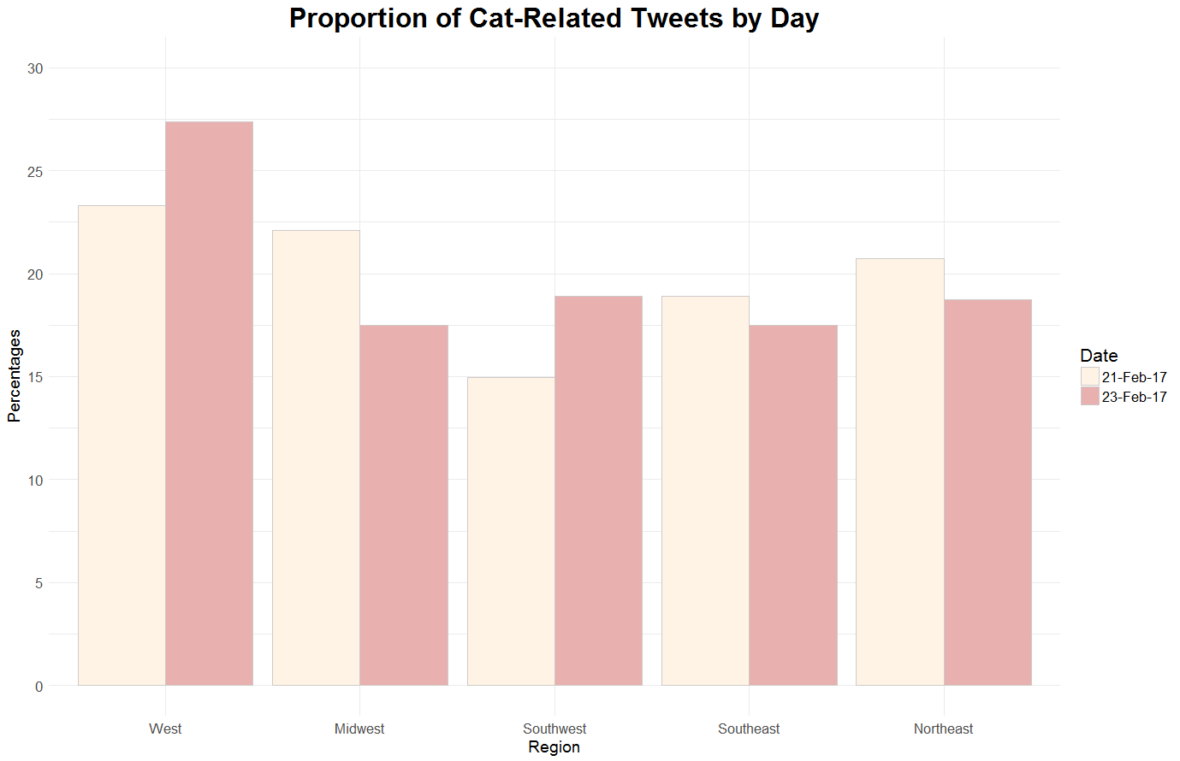

Slide 9
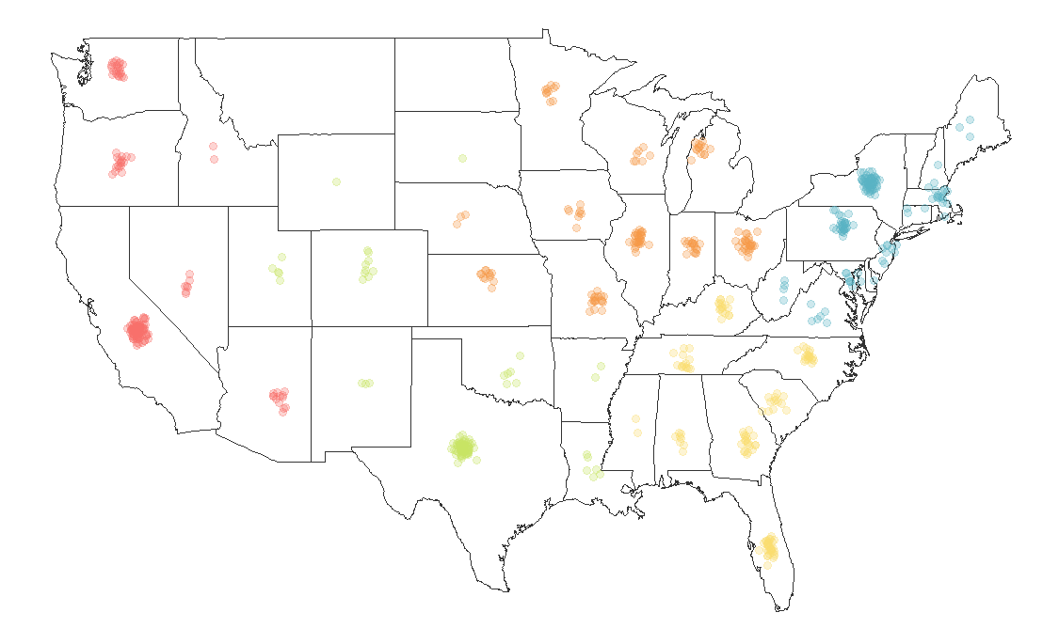
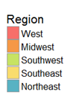
Map of Twitter Posts from Feb. 21, 2017
656 tweets

Slide 10
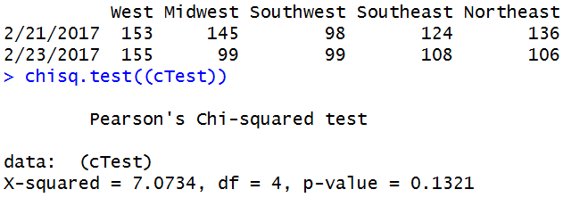
Chi-Squared Test
H₀: The distribution of tweets across geographic regions is not associated with the day.
H_{A}: The distribution of tweets across geographic regions is associated with the day.
Significance Level: 0.05
Fail to reject null hypothesis

Slide 11


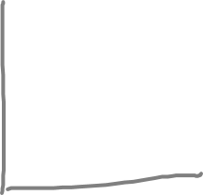


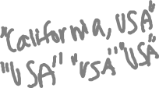

Lots of data is lost
Only text-based tweets are considered
Not representative of total population
Use a larger sample size
Longer time periods
By state instead of region

Slide 12

Dr. Garrett Dancik
Professor at Eastern Connecticut State University
Nathan Lawlor

Slide 13






Slide 14

Objective: Find the region of the U.S. that is most interested in cats
For both days, the West region had the highest proportion of cat tweets, 23.3% (153/656) and 27.3% (155/567)
The null hypothesis is not rejected 0.1 ≮ 0.05
Software: TwitteR package

